Slide 1
Partition-based scheduling
Multicore Systems

Slide 2
Contents
Motivation
Background
Scheduling multi-core systems
Semi-partitioned Scheduling
Proposed strategy
Implementation and Example
Overview and Conclusion
References

Slide 3
Motivation
Mixed Criticality Systems: Some tasks critical than others.
Challenges:
Task allocation
Resource Allocation
Increasing computational demand.
Advances in integrated circuit miniaturization.
Solution: Multicore systems.

Slide 4
Motivation
Intel analyst: “Multi-core processors are the inevitable product of Moore‘s Law.”
Task isolation and mutual interference is achieved.
Increasing cores in a process results in:
Parallel task execution.
Enhances energy efficieny.
Higher bandwidth.
Lower communication latency.
Challenges of scheduling tasks on multicore systems:
Spatial organization: assigning task to a care.
Temporal organzation: determining execution order.
Bin-packing type problem in resource utilization.
Semi-partitioned scheduling is proposed.

Slide 5
Motivation
Semi-partitioned scheduling: Tasks statically assigned to fixed cores.
Cores must pass schedulability test.
Communication tasks are grouped in a cluster.
Advantages:
Minimizes communication costs.
Balances load across cores.
Improves system feasiblity.

Slide 6
Background
Categorization of multi-core processors:
Homogeneous Multi-Core Processors: Integrates multiples identical cores on a single chip.
Heterogeneous Multi-Core Processors: A complex superscalar core handles general purpose computation.
Heterogeneous Multi-Core Processor is the focus of this research.

Slide 7
Background
Classifications of real-time tasks:
Periodic Tasks: Consist of infinite sequence of identical instances activated at a constant rate.
Aperiodic Tasks: Activations are unpredictable.
Sporadic Tasks: Aperiodic execution constrained by minimum inter-arrival time.
Periodic Tasks form the majority of tasks in a real-time application.

Slide 8




Background
Periodic Task $T_{i}$ has the following parameters:
Period: Time interval between successful arrival of the task.
Worst-Case Execution Time: Maximum time a particular task can take to execute.
WCET
WCET
WCET
Period of $T_{0}$
Period of $T_{0}$
Period of $T_{0}$
Fig. 1: Characteristics of periodic Task

Slide 9
Background
Scheduling Policy: Determination of order of task execution.
Different classes of scheduling algorithms: preemptive, static, dynamic, optical, heuristic etc.
Heuristic: Tends towards to optimal schedule but does guarantee finding it.
Heuristic based scheduling are classified into three classes:
Priority based scheduling: Tasks scheduled according to calculated priorities.
Duplication-based scheduling: Predecessor tasks are duplicated to occupy idle times.
Cluster-based scheduling: Communication tasks grouped together to form clusters which are scheduled to available core or cores.

Slide 10
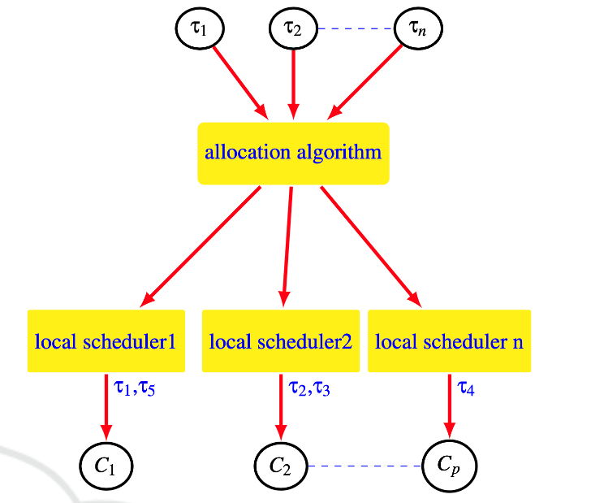
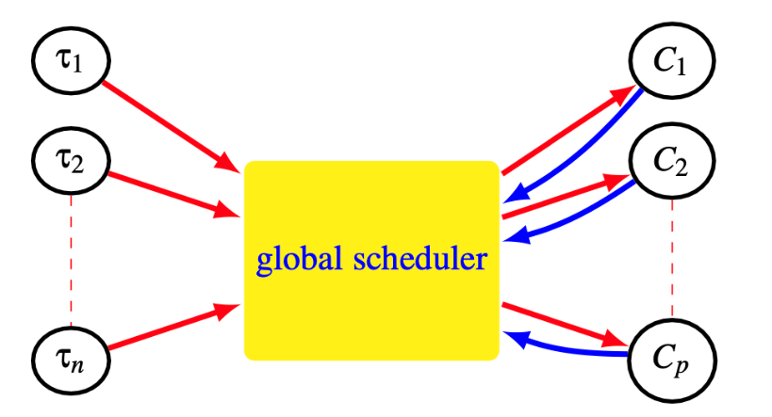

Scheduling multi-core systems
Two fundamental approaches:
Global Scheduling: Task may execute on any core and migration is allowed.
Partition-based scheduling: Tasks statically assigned to cores.
Fig. 2: Global Scheduling
Fig. 3: Parition-based scheduling

Slide 11
Semi-partitioned Scheduling
Partitioning can lead to resource underutilization.
Semi-partitioned scheduling is proposed:
Two parts of semi-partitioned schedulging algorithm:
Partitioning algorithm: Determines how to split and assign each task to a fixed processor.
Scheduling Algorithm: Determines how to schedule tasks assigned to each processor.
Tasks are assigned in same or neighbouring cores to reduce communication overhead.

Slide 12
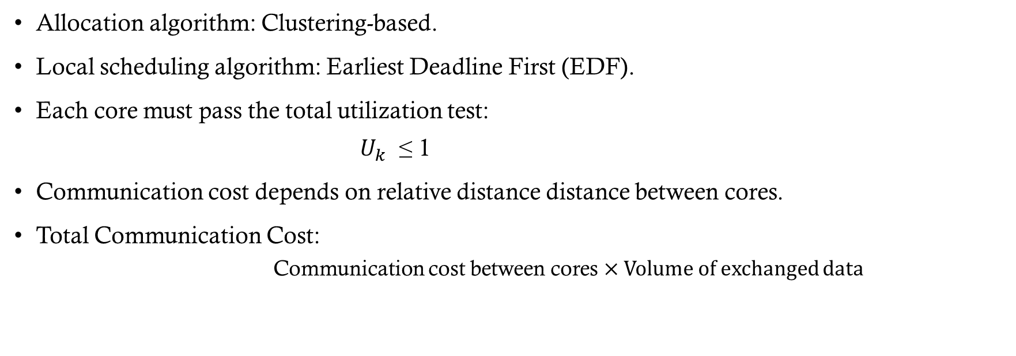
Proposed strategy
Allocation algorithm: Clustering-based.
Local scheduling algorithm: Earliest Deadline First (EDF).
Each core must pass the total utilization test:
$U_{k}$ ≤ 1
Communication cost depends on relative distance distance between cores.
Total Communication Cost:
Communication cost between cores × Volume of exchanged data

Slide 13
Implementation and Example
Algorithm1: Assign Clusters to Cores
1: for each cluster in clusters do
2: Find the least-loaded core that can still take the cluster‘s total utilization.
3: Assign all tasks in the cluster to that core.
4: Update the core‘s utilization.
5: end for

Slide 14
Implementation and Example
Task Number | Execution Time | Period
0 | 1 | 5
1 | 2 | 10
2 | 1 | 4
3 | 2 | 8
4 | 3 | 4
5 | 1 | 10
6 | 5 | 6
Table 1: Task Parameters

Slide 15
Implementation and Example
 | T0 | T1 | T2 | T3 | T4 | T5 | T6
T0 | 0 | 5 | 3 | 9 | 0 | 0 | 0
T1 | 5 | 0 | 4 | 7 | 0 | 0 | 0
T2 | 3 | 4 | 0 | 0 | 0 | 0 | 0
T3 | 9 | 7 | 0 | 0 | 0 | 8 | 0
T4 | 0 | 0 | 0 | 0 | 0 | 0 | 7
T5 | 0 | 0 | 0 | 8 | 0 | 0 | 0
T6 | 0 | 0 | 0 | 0 | 7 | 0 | 0
Table 2: Task dependency matrix

Slide 16
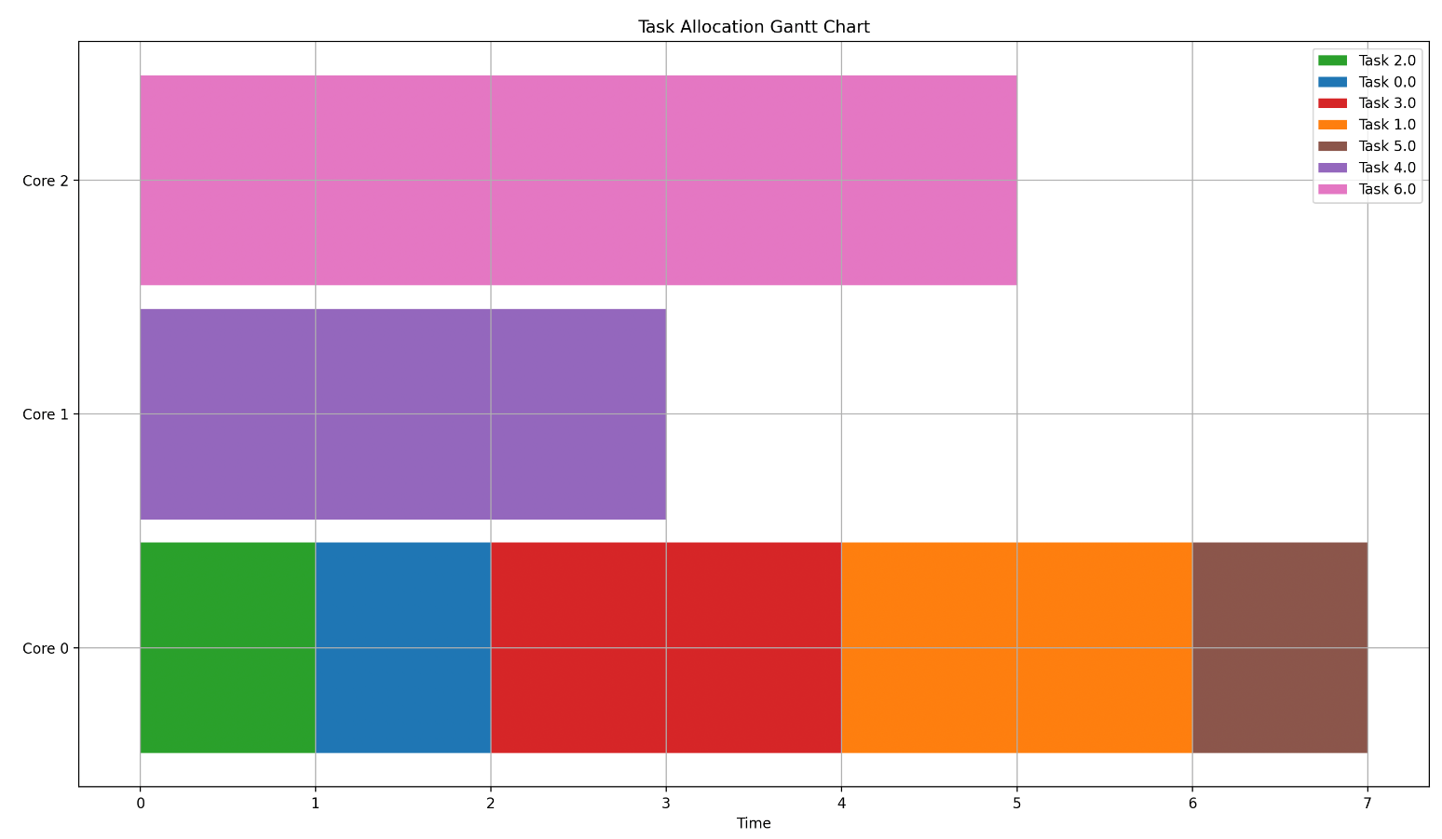
Implementation and Example
Fig. 4: Task dependency matrix

Slide 17
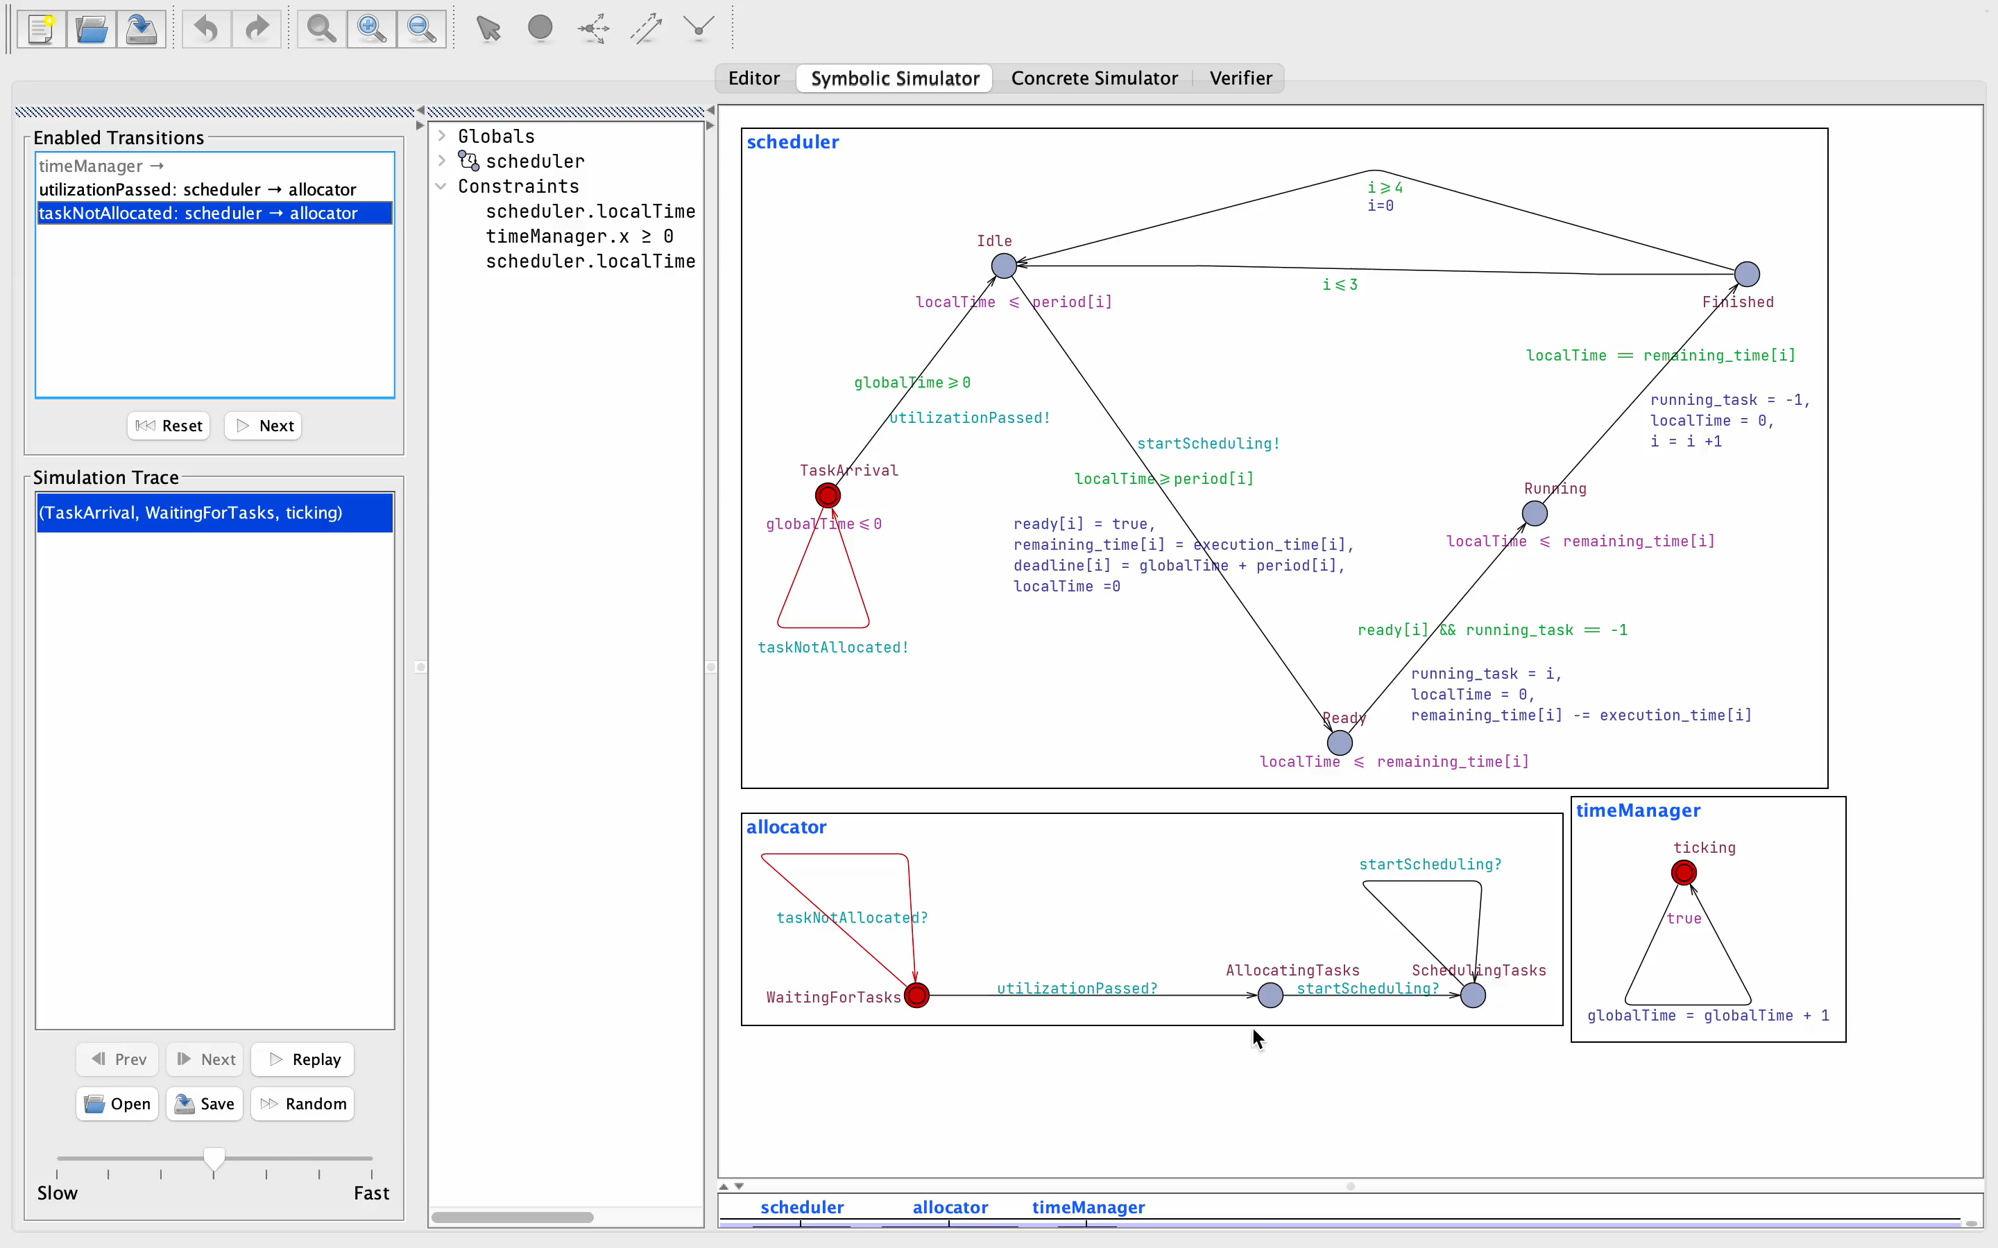
Implementation and Example

Slide 18
Overview and Conclusion
Partition-based scheduling is explored.
Allocation of periodic tasks on homogeneous multi-core architecture is discussed.
Scheduling and allocation algorithm implemented in C.
Simulation illustrated in UPPAAL.
Tasks with frequent communication formed cluster.
Clusters allocated on nearby cores, with schedulability constraints.
Communication cost reduced.

Slide 19
References

